Slide 1

CENG 789 – Digital Geometry Processing
01- Introduction
Assoc. Prof. Yusuf Sahillioğlu
Computer Eng. Dept, , Turkey

Slide 2
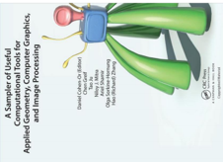
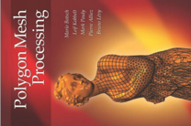

Administrative
<number> / 51
Tue 14:40-17:30 @ G102.
www.ceng.metu.edu.tr/~ys/ceng789-dgp/
Grading
  40%: 2 programming assignments.
  40%: Term Project.
  20%: Final Exam.
Reference book: Polygon Mesh Processing:
C++ programming required.
  Code framework including 3D UI will be provided.
Similar courses.
  EPFL, M. Pauly.
  Stanford, V. Kim.
  Technion, M. Ben-Chen.
Instructor: Yusuf Sahillioğlu (ys@ceng.metu.edu.tr)
(office: B107)

Slide 3
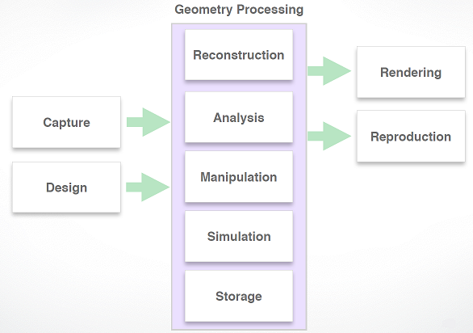
Objective
<number> / 51
Learn concepts and algorithms for a complete geometry processing system.

Slide 4
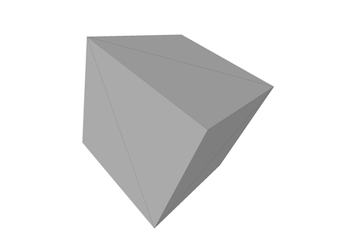
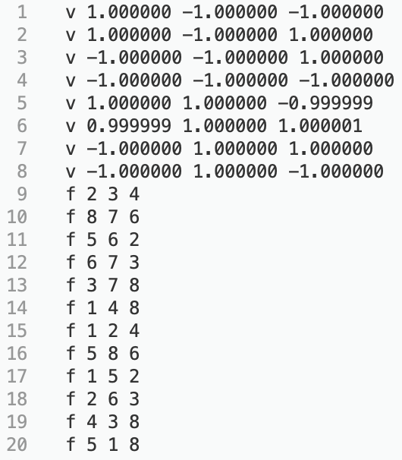
Objective
<number> / 51
Typically geometry comes through a mesh structure.

Slide 5
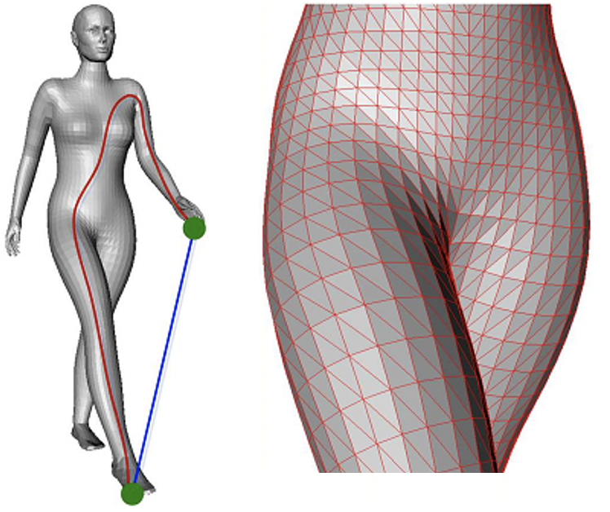
Objective
<number> / 51
Typically geometry comes through a mesh structure.

Slide 6
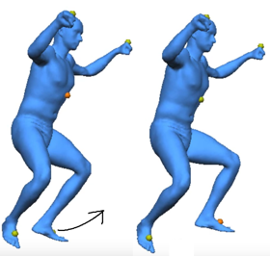

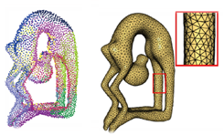

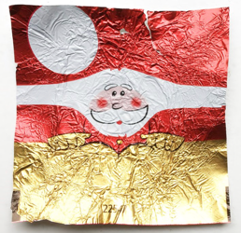
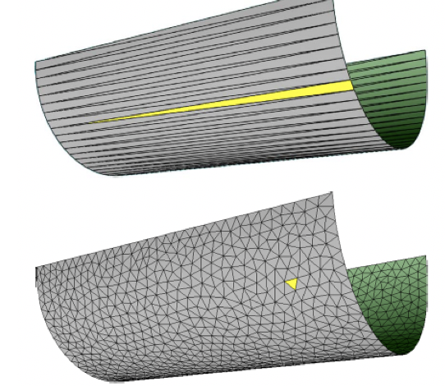
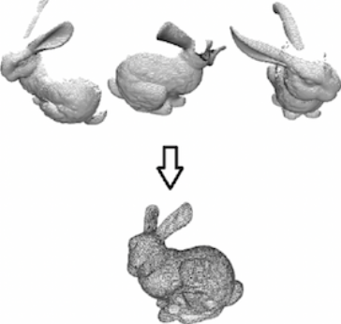
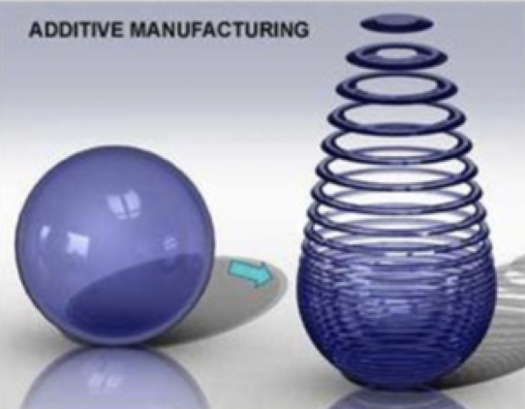
Objective
<number> / 51
We mostly deal with
Reconstruction
Analysis Manipulation/Editing Parameterization
Visualization Remeshing Registration 3D Printing

Slide 7
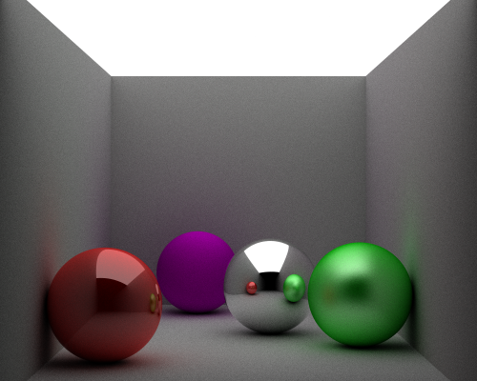



Objective
<number> / 51
We don’t deal with Computer Graphics material (take CENG 477)
  Rendering
    Ray tracing
    Rasterization
  Transformations
y
y
x
x
z
z

Slide 8
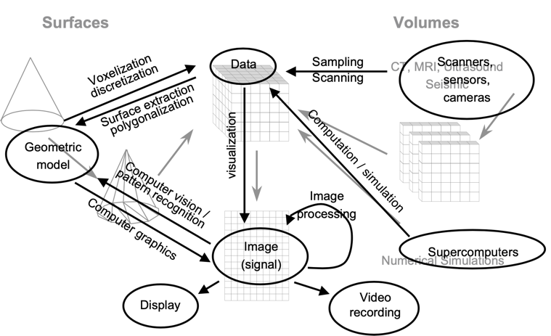
Objective
<number> / 51
Connecting terms: geometric modeling, graphics, vision, visualization, ..

Slide 9
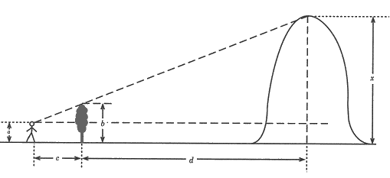
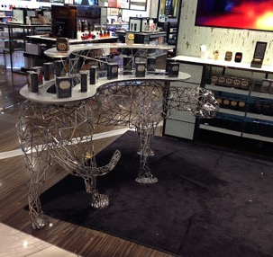
Why do we care?
<number> / 51
Geometry: geo (earth) + metron (measurement)
From ancient times:
To modern times:
Notes:
Send a slave to measure the distance from the tree to the mountain by foot steps. Come next to the tree. Bend until you see the top of the mountain from the top of the tree. Measure the height of your eye from the ground. Measure your distance to the tree. Use triangle similarity.

Slide 10
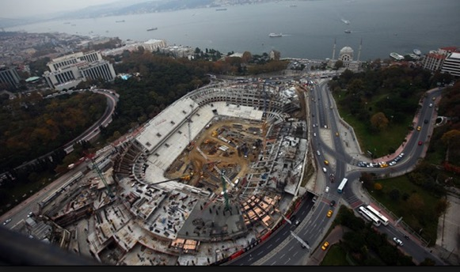
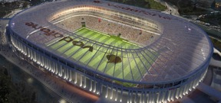
Geometric Digital Modeling
<number> / 51
Geometric objects in the world are digitally modeled (representation) for
  easy manipulation
  easy repairing
  easy comparison
  easy synthesis
  cheaper simulation
Digitially modeled
(designed on a computer)

Slide 11
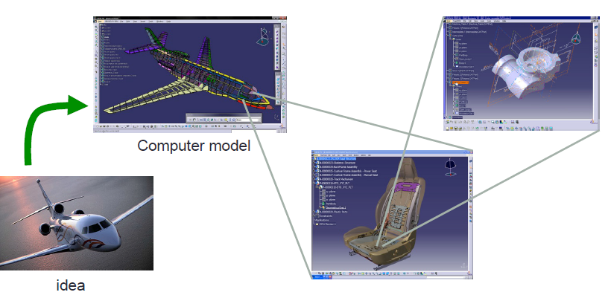
Digital Models
<number> / 51
Geometric objects in the world are digitally modeled (representation).

Slide 12
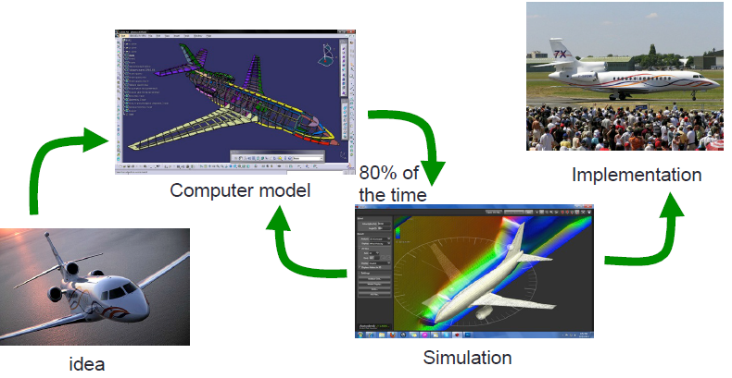
Digital Models
<number> / 51
Geometric objects in the world are digitally modeled (representation).

Slide 13
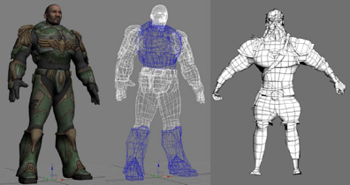
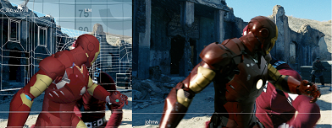
Digital Models
<number> / 51
Digital models are used in
  video games
  3d cinema

Slide 14
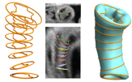
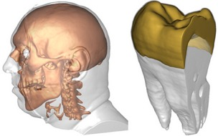

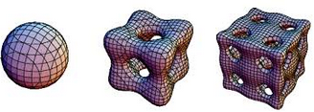
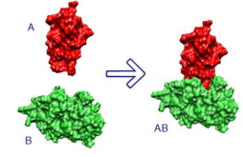
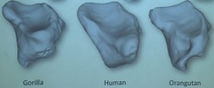
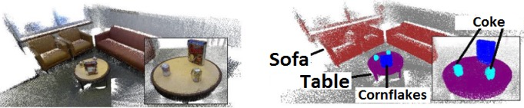
Digital Models
<number> / 51
Digital models are used in
  medicine, esthetics
  paleontology., math, other sciences
  robotics, autonomous driving

Slide 15
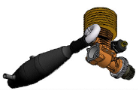
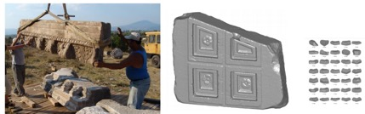
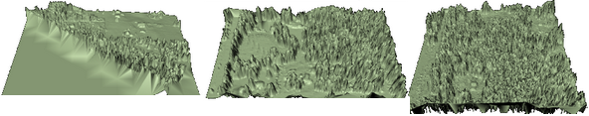
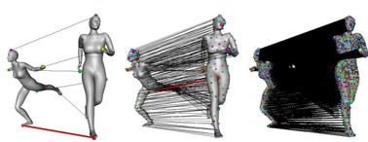

Digital Models
<number> / 51
Digital models are used in
  cultural heritage (reconstruction, matching)
  geological data
  new digital model creation
  engineering

Slide 16
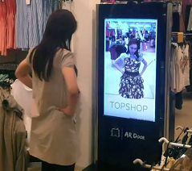

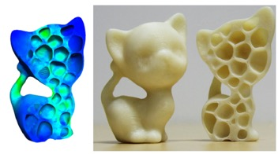
Digital Models
<number> / 51
Digital models are used in
  virtual shopping (AR)
  fabrication (3d printing)

Slide 17

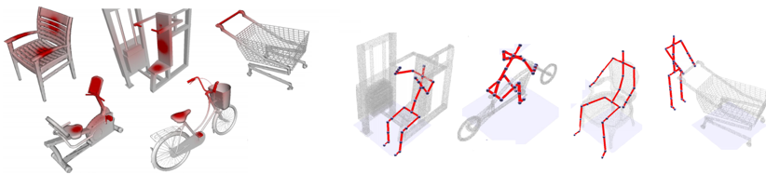
Digital Models
<number> / 51
Digital models are used in
  virtual reality (VR)
  simulation (ergonomy etc.)

Slide 18
Digital Models
<number> / 51
Digital models are useful because
  A digital model allows easy manipulation.
  Digital simulation is much cheaper.
  Model optimization and repair is possible.
  Comparison across models is easy.
  Creation of new models from other ones is easy.

Slide 19
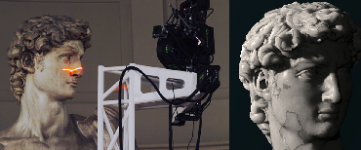
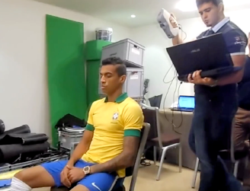
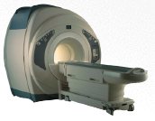
Geometry Capture
<number> / 51
Static.

Slide 20
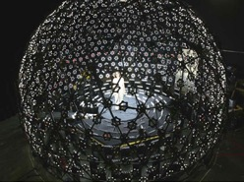
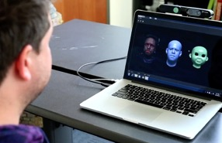
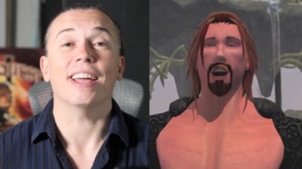
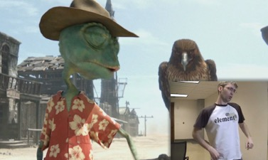
Geometry Capture
<number> / 51
Dynamic (performance capture).

Slide 21
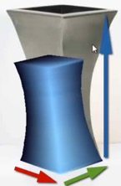
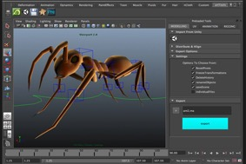
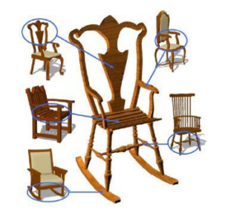
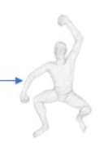

Geometry Creation
<number> / 51
Artists/interactive modeling.
Automated tools.

Slide 22
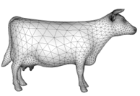
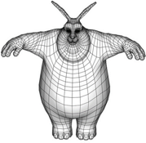

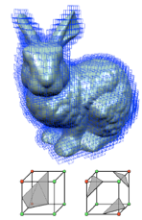
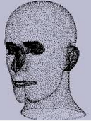



Geometry Representation
<number> / 51
We are interested in thin-shell surfaces, represented by polygon meshes: set of polygons representing a 2D surface embedded in 3D.
Other representations.

Slide 23


Polygon Mesh
<number> / 51
Why polygon meshes as discretization of surfaces?
  Surface of a solid shape is sufficient for
    Rendering
    Adaptive refinement
    Similarity comparison
    New surface generation
    Segmentation
    Many other analyses
  Not realistic for deformations though (use tetmeshes here).

Slide 24





Polygon Mesh
<number> / 51
Polygon meshes are piecewise linear surface representations.
Analogous to piecewise functions:
Think surface as (the range of) a “shape” function.
vs.
Notes:
You could also define a surface implicitly as the zero set of a scalar-valued function F : R^2 → R, i.e. surface = {x \in R^2 | F(x) = 0}
For instance, same circle defined with the parametric representation above can be defined with the implicit representation as follows: (x, y) → sqrt(x^2 + y^2) – r //2D points (x, y) that make the righthandside 0 are the circle points.

Slide 25


Polygon Mesh
<number> / 51
1D: This line piece approximates the given shape (circle) only locally.
2D: This triangle piece approxs the given shape (sphere) only locally.

Slide 26
Polygon Mesh
<number> / 51
Approximation error decreases as # pieces increases.

Slide 27

Polygon Mesh
<number> / 51
Approximation error is quadratic.
  As # pieces doubled, error decreases one forth.
Notes:
Another way to decrease error is using non-linear pieces (instead of 1D-lines or 2D-triangles/quads) such as spline surfaces. But not preferred ‘cos with such higher-degree polynomials smoothness conditions between pieces are sometimes quite difficult to satisfy.

Slide 28



Polygon Mesh
<number> / 51
Polygon meshes are C ⁰ piecewise linear surface representations.
Smoothness levels:
C ⁰: Position continuity C ¹: Tangent continuity C ²: Curvature continuity

Slide 29


Polygon Mesh Types
<number> / 51
Manifold meshes: keep things simple.
  Images: assume every pixel has 4 neighbors. Likewise, assume meshes are manifold. It keeps formulas simple and leads to fewer special cases in code.
    Edges are contained in at most 2 polygonal faces.
    Vertices are contained in disk of triangles.
Watertight meshes are 2-manifold meshes w/o boundary edges.
  Suitable for simulations and 3D printing.
No holes or non-manifold structures.
Closed mesh (no boundary edges).
Euler’s formula (slide 36) applies.
Imagine filling the inside of the mesh
w/ water, would anything leak out? If not,
then chances are the mesh is watertight.

Slide 30


Polygon Mesh Types
<number> / 51
Notes:
2-manifold: if, for each point, the surface is locally homeomorphic to a disk (or a half-disk at boundaries).
A triangle mesh is a 2-manifold if it contains neither non-manifold edges nor non-manifold vertices nor self-intersections (red stuff above).
Non-manifold meshes are problematic for most algorithms, since around non-manifold configurations there exists no well-defined local geodesic neighborhood.
Types of edges: boundary (adjacent to 1 face), regular (adj. to 2 faces), singular (adj. to 3+ faces).
Closed polygon meshes are also known as polyhedra: bounded region of space whose boundary is composed of flat polygonal faces.

Slide 31




Triangle Meshes
<number> / 51
Most common piece is triangles (quads come second).
A set of triangles (embedded in 3D or 2D) that are connected by their common edges or corners.
Each triangle defines, via its barycentric parameterization, a segment of a piecewise linear surface representation, so that you can, e.g., interpolate function values at triangle vertices a, b, and c.

Slide 32


Triangle Meshes
<number> / 51
An undirected graph, with triangle faces.

Slide 33

Triangle Meshes
<number> / 51
An undirected graph, with triangle faces.
Vertex degree or valence = # incident edges
deg(A) = 4 deg(B) = 3
k-regular mesh if all vertex degrees are equal to k.

Slide 34

Triangle Meshes
<number> / 51
An undirected graph, with triangle faces.
connected if every pair of vertices
are connected by a path (of edges).

Slide 35

Triangle Meshes
<number> / 51
A specific undirected graph: straight-line plane graph (embedded in 2/3D) where every face is a triangle, a.k.a. triangulation.
Planar graph: graph whose vertices and edges can be embedded in 2D without intersecting edges.
  Planar graph Plane graph Straight-line plane graph

Slide 36

Mesh Statistics
<number> / 51
Euler formula for connected planar graphs help us derive mesh stats.
Holds for triangle, quad, pentagon, .. faces, i.e., polygon faces.
V – E + F = 2
Triangle mesh is
a planar triangulation
embedded in R³.

Slide 37



Mesh Statistics
<number> / 51
Proof of Euler’s formula: V – E + F = 2
Proof: Induct on E, # edges.
Base Case: 2 – 1 + 1 = 2 //holds ☺
Inductive Step: Assume formula is True for planar subgraph with E edges. Show that it must also be T for planar graph with E+1 edges.
→
Add new (red) edge → V – (E + 1) + (F + 1) = 2 ☺ ‘cos
V – E + F = 2 by inductive hypothesis.

Slide 38


Mesh Statistics
<number> / 51
Based on Euler’s formula, we can derive:
  F ~ 2V
  E ~ 3V
  Average vertex degree is 6.
for a closed triangular mesh.
Proofs:
For E ~ 3V: count 3 edges for each face → 3F = E
this way each edge counted twice → 3F = 2E
V – E + F = 2 → V – E + 2E/3 = 2 negligible →E ~ 3V
For F ~ 2V: V – E + F = 2 → V – 3F/2 + F = 2 negligible → F ~ 2V
For avg degree = sum_v deg(v) / V = 2E / V //by handshaking lemma
= 6V / V = 6.

Slide 39


More on Euler’s Formula
<number> / 51
There are lectures and books about this Euler’s formula: V-E+F=2
Although it’s about Topology, it still relates to our Geometry Processing class, e.g., for topology-invariant shape analysis.
As applications, let’s see how it helps to prove some cool theorems.

Slide 40

More on Euler’s Formula
<number> / 51
Theorem: there are at most 5 Platonic Solids.
Named after Greek philosopher Plato.
Congruent (identical in shape and size), regular (all angles/sides equal) polygonal faces with the same number of faces meeting at each vertx.

Slide 41
More on Euler’s Formula
<number> / 51
Theorem: there are at most 5 Platonic Solids.
Proof: n = # of edges on each face, m = # of edges meeting at a vert.
F x n counts each edge twice ➔ E = F x n / 2
F x n counts each vertex too many times ➔ V = F x n / m
V – E + F = 2 ➔ Fn/m – Fn/2 + F = 2 ➔ F = 4m / (2n – mn + 2m)
2n – mn + 2m > 0 ‘cos we want a +ve # of faces ➔ 2n > m (n - 2)
n, m >= 3 ‘cos every face of a polyhedron has at least 3 edges (triangular) and each vertex appears in at least 3 edges (closed).
2n / (n-2) > m >= 3 ➔ 2n > 3n – 6 ➔ n < 6, by symmetry m < 6
(n,m) = {(3,3), (3,4), (3,5), (4,3), (5,3)}, e.g., first one is tetrahedron.

Slide 42

More on Euler’s Formula
<number> / 51
Theorem: there are at most 5 Platonic Solids.
We gave a topological/combinatorial proof that did not take geometry into account: side lengths and angle measures (regularity) ignored.
We proved that our Platonic Solids resemble Tet, Cube, Oct, Dod, Ico.
See Euclid’s geometrical proof forthe existence of exact Platonic Solids.

Slide 43

More on Euler’s Formula
<number> / 51
Theorem: if every face of a polyhedron is a pentagon or a hexagon and if the degree of every vertex is 3 (soccer ball), then the polyhedron has exactly 12 pentagonal faces.

Slide 44
More on Euler’s Formula
<number> / 51
Theorem: if every face of a polyhedron is a pentagon or a hexagon and if the degree of every vertex is 3 (soccer ball), then the polyhedron has exactly 12 pentagonal faces.
Proof: P = # of pentagonal faces, H = hexagonal.
5P + 6H counts each edge twice ➔ E=(5P+6H)/2
5P + 6H counts each vert thrice ➔ V=(5P+6H) / 3
V – E + F = 2 ➔ =(5P+6H) / 3 - (5P+6H)/2
+ (P+H) = 2 ➔ 10P+12H-15P-18H+6P+6H = 12 = P

Slide 45



More on Euler’s Formula
<number> / 51
Theorem: if every face of a polyhedron is a pentagon or a hexagon and if the degree of every vertex is 3 (soccer ball), then the polyhedron has exactly 12 pentagonal faces.
Rest assured, a golf ball, fullerene (carbon), or soccer ball is not a sixth Platonic Solid: close inspection reveals pentagon/hexagon hybrid.

Slide 46


More on Euler’s Formula
<number> / 51
Theorem: K₅ is not planar.
Proof: suppose it is. Then,
V – E + F = 2 ➔ 5 – 10 + F = 2 ➔ F = 7 (including exterior).
Closed triangle mesh: Each edge borders 2 faces, every face has exactly 3 edges ➔ 3F counts each edge twice ➔ 3F = 2E (slide 38).
K₅: Each edge borders 2 faces, every face has at least 3 edges ➔ 3F <= 2E ➔ 21 <= 20 is a contradiction so K₅ is not planar.
3F = 2E //each face has 3 edges
4F = 2E //each face has 4 edges
5F = 2E //each face has 5 edges
.
.
So, 2E is at least 3F ➔ 3F <= 2E

Slide 47

More on Euler’s Formula
<number> / 51
Theorem: K₅ is not planar.
Theorem: K_{3,3} is not planar.
Why do we care?
Theorem (Kuratowski): Graph G is planar iff it does not have K₅ or K_{3,3} as a subgraph.
So regardless how large G is, you can reason about its planarity fastly.

Slide 48




More on Euler’s Formula
<number> / 51
Theorem (6-color): Every connected planar G can be properly colored w/ 6 or less colors.
  5-color proved (harder). 4-color also proved via computers (controversial).
Proof: Induct on V, # vertices.
Base: 1 <= V <= 6 colored by assigning a different color to each vert.
Inductive Step: Every connected planar G contains a vertex v of degree 5 or less (proof next slide via Euler). Remove v. Resulting sub-graph can be colored w/ 6 or less colors (induction), so color it.
Now add v back using the 6th color:

Slide 49



More on Euler’s Formula
<number> / 51
Theorem: Every connctd planar graph has a vertex of degree 5 or less.
Proof: enlarge graph by adding edges so all faces are triangles and still planar. Exterior face has 3 curvy edges.
Proving that enlarged G has a vert v with degree 5- does the job ‘cos we just added edges, meaning that v must exist in the original G (with a less than or equal to degree value compared to the v in enlarged G.)
3F = 2E (slide 38) ➔ V – E + F = 2 ➔ V – 2 = E – F ➔ 6V – 12 = 6E – 6F ➔ 6V – 12 = 2E.
Sum of all degrees is 2E (handshaking). So, average degree is 2E / V = (6V – 12) / V = 6 – 12/V < 6.
Average degree is less than 6 ➔ there must be 1+ vert w/ degree 5-.

Slide 50


More on Euler’s Formula
<number> / 51
Generalized Euler Formula:
V – E + F = 2(1-g)
where g is the genus of the surface, i.e., # handles of an object.

Slide 51



Some Cool DGP videos
<number> / 51
Modeling.
  Zoomorphic: https://youtu.be/0gWomNI9CuI
  Blending: https://youtu.be/U_XfYzy2c9w or https://youtu.be/WWLHPKsExaI
  PCA: https://youtu.be/nice6NYb_WA
  Printing: https://youtu.be/_drZksLRx94 or https://youtu.be/kFkD45NUIzQ
  Segmenting: https://youtu.be/KTBdmY4U5Yw or https://youtu.be/aahC7i7FpTc
  Multi-resolution: https://youtu.be/tTEGDPHv_AI
  Image-guided: https://youtu.be/bmMV9aJKa-c
3D-supported Image Editing.
  Sweeping & PCA: https://youtu.be/Oie1ZXWceqM & /9LJ-Gn5BM7A
Deformation.
  Energy-based: https://youtu.be/dERjpAaoNjk or youtu.be/F0ijAzOOWR4 https://youtu.be/QgrQuBwlbSE or /8C3uZOXLBIA or /bmMV9aJKa-c
  Physically-based: https://youtu.be/CCIwiC37kks
Exploration and organization of large 3D collections.
  https://youtu.be/cmmCVrbgpnU
Notes:
DBs that might be useful: http://gaps-zju.org/facewarehouse/ http://people.sutd.edu.sg/~saikit/projects/sceneNN/
Top figure: Exploration of Continuous Variability in Collections of 3D Shapes, Bottom figure: Qualitative organization of collections of shapes via quartet analysis.
Fit and Diverse paper is another cool example for Modeling/Blending part.
Man image from: Modeling from Contour Drawings.

